Slide 1

ANALYZATION AND DETECTION OF PCOS
By:
Cindy Hightower
Aprian Torang
Afifah Muhsinatu Mardiah
Polina Savina

Slide 2
TASKS
Explore the PCOS dataset to understand its structure and features.
Identify missing values, outliers, and patterns in the data.
Select relevant physical and clinical parameters for PCOS and infertility detection.
Perform any necessary preprocessing steps, such as handling missing values or encoding categorical variables.
Choose appropriate machine learning models for binary classification (e.g., Logistic Regression)
Train the model on the training set and evaluate its performance on the testing set.
Explore different classification metrics (accuracy, precision, recall, F1 score).
Formulate hypotheses related to PCOS and infertility based on the dataset.
Use appropriate statistical tests to test these hypotheses.
Create visualizations to support your findings and enhance the interpretability of the model.
Summarize your results, including key insights into physical and clinical parameters associated with PCOS and infertility.

Slide 3
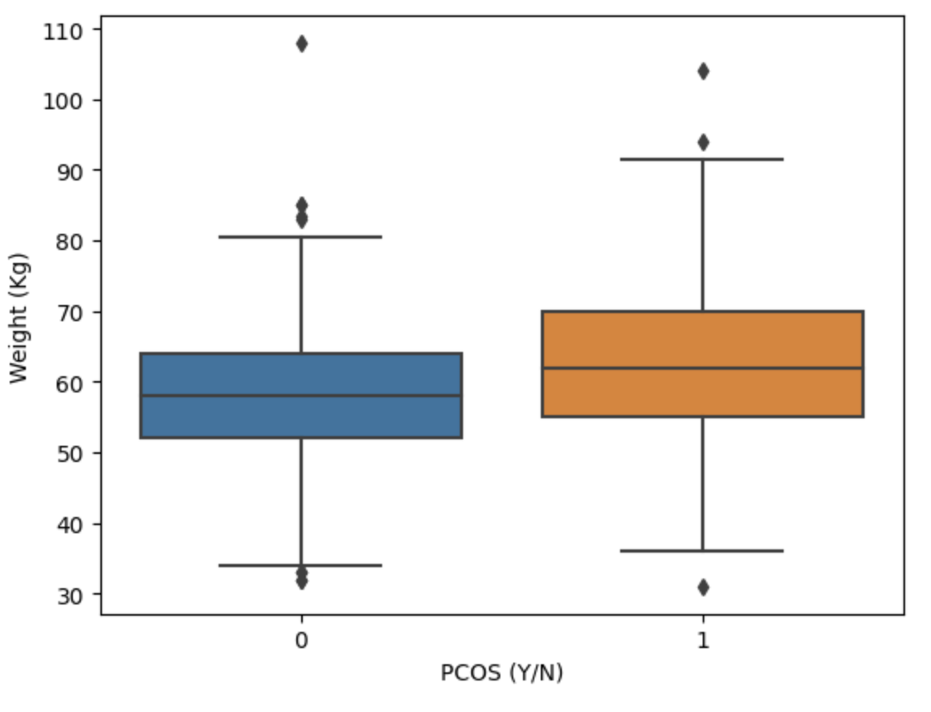
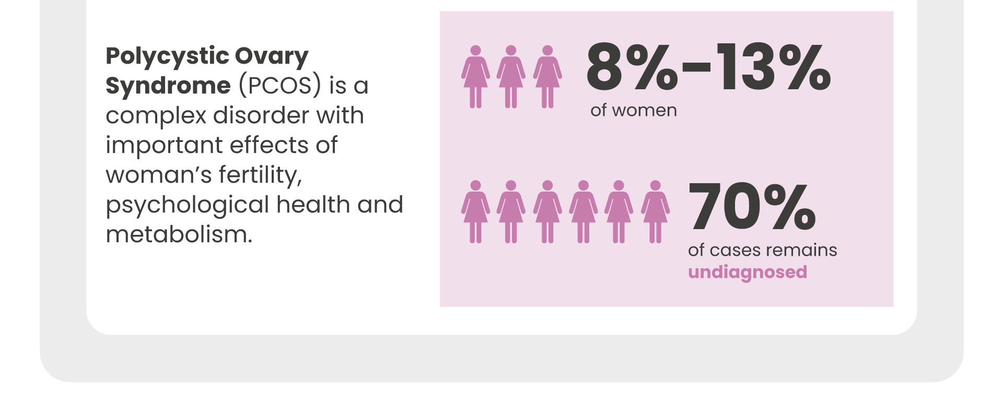
Polycystic ovary syndrome (PCOS) Pcos dataset contains all physical and clinical parameters of patients without infertility
Structure and Features: the dataset comprises a comprehensive array of demographic, physiological, and medical attributes related to Polycystic Ovary Syndrome (PCOS).

Slide 4
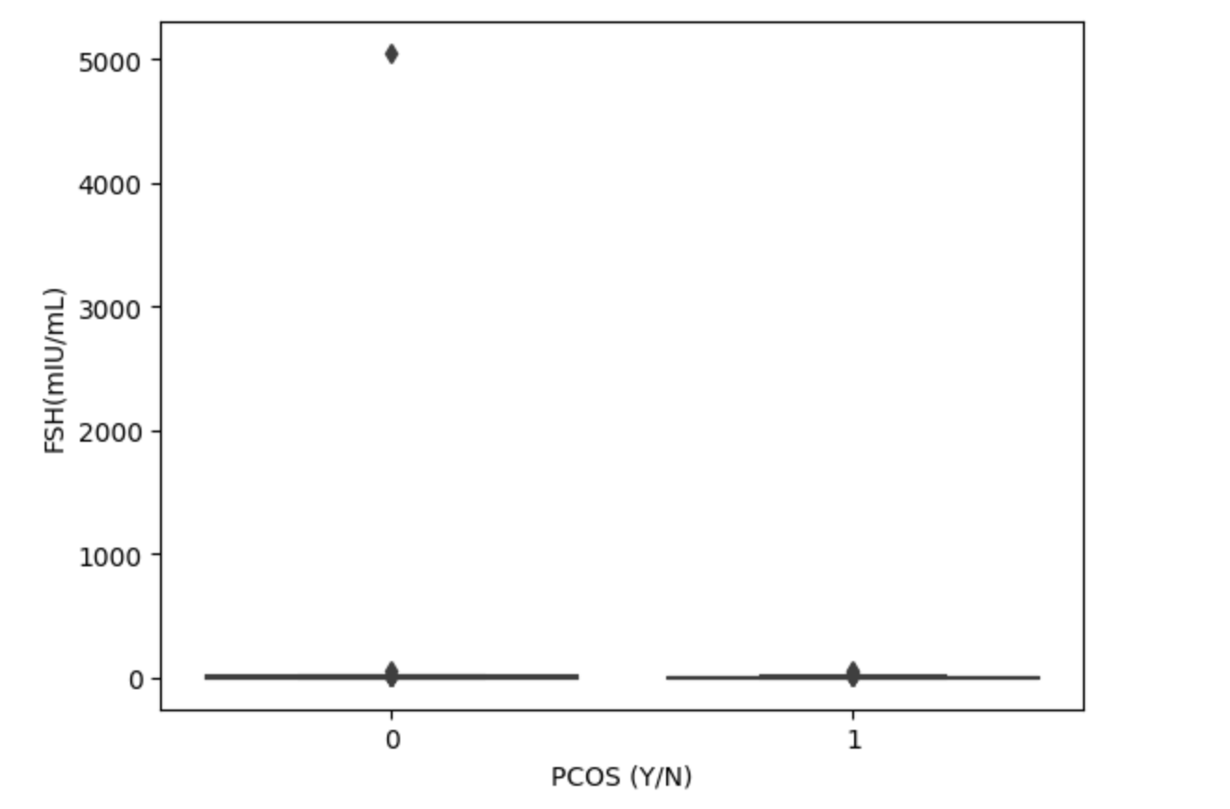
Polycystic ovary syndrome (PCOS) Pcos dataset contains all physical and clinical parameters of patients with infertility
Structure and Features: this dataset comprises records of patients possibly diagnosed with Polycystic Ovary Syndrome (PCOS), indicated by a binary (Y/N) classification.

Slide 5
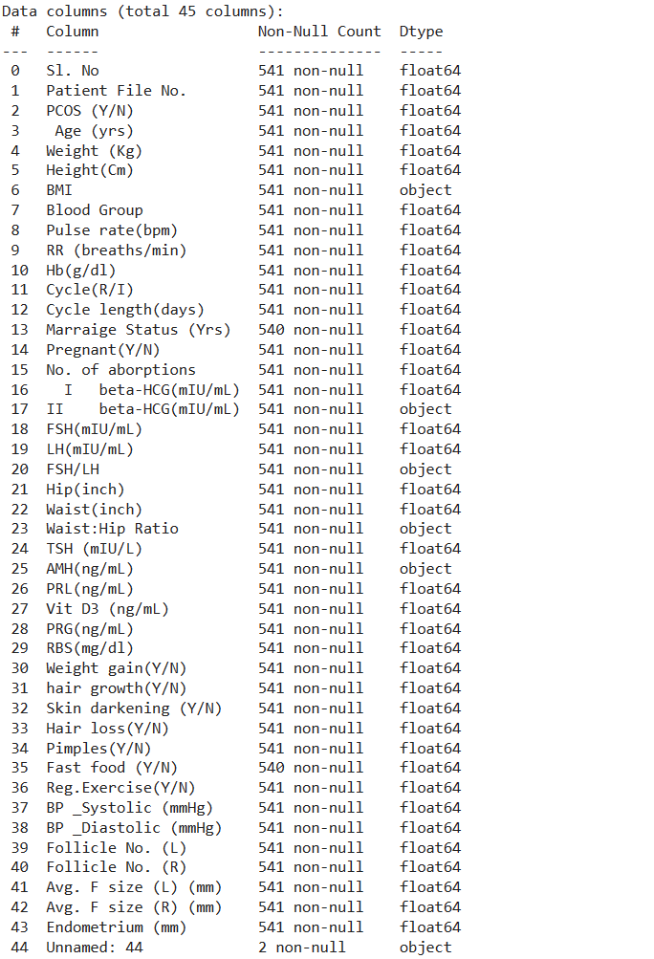
DATA DESCRIPTION
Total Parameter: 45 parameters
Used Parameter: 39 parameters

Slide 6
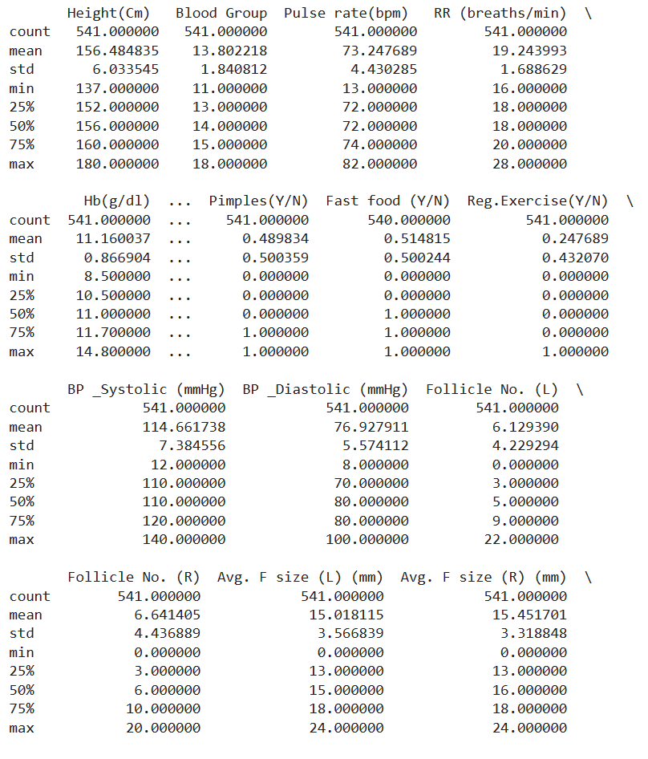
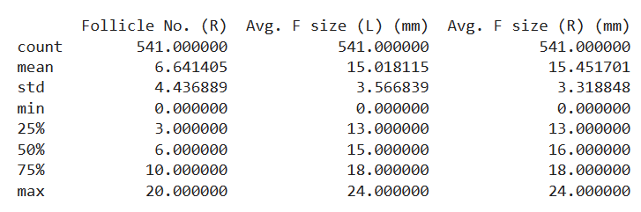
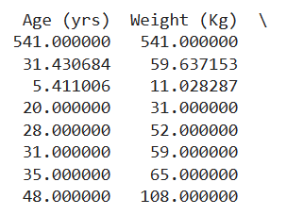
DATA DESCRIPTION
Total Data: 541 data set

Slide 7
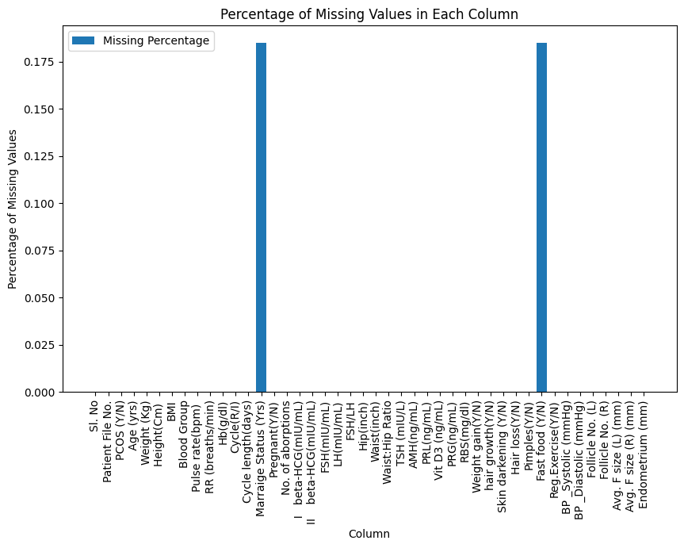
MISSING VALUES & OUTLIERS
Column | Missing values | Percentage | Total Data
Marriage Status | 1 | 0.18% | 541
Fast food (Y/N) | 1 | 0.18% | 541
There are no detected outliers based on a threshold of z > 3 or z < -3. This indicate that the numerical data within these columns is relatively normally distributed, without extreme deviations from the mean.

Slide 8
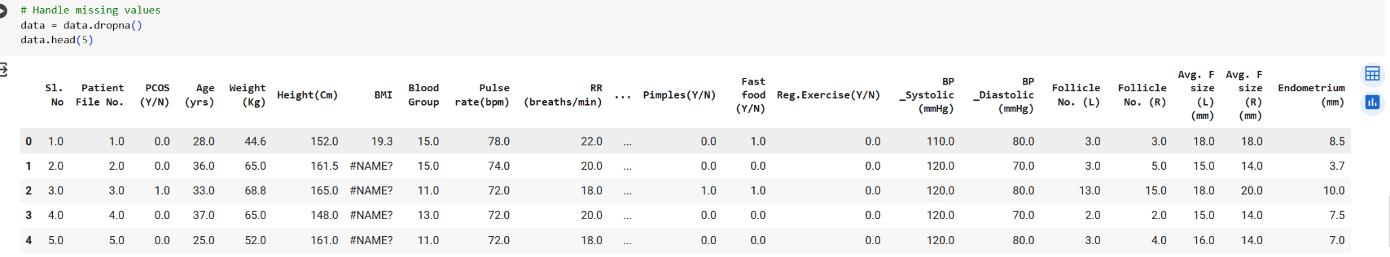
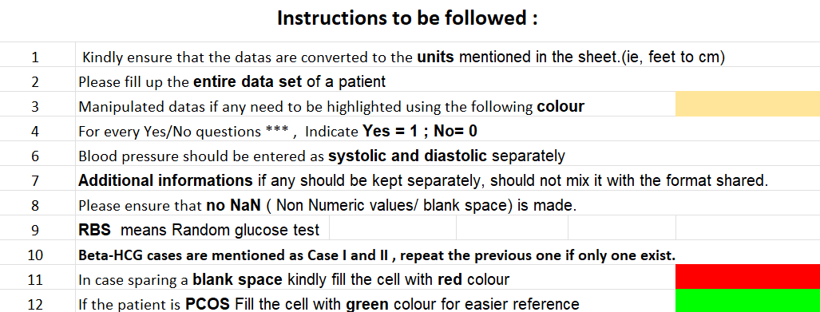
HANDLING MISSING VALUES

Slide 9
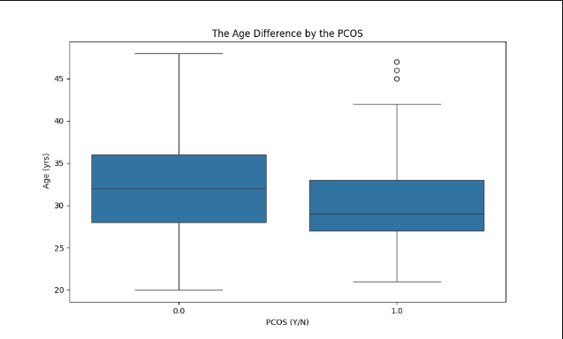
PCOS Hypothesis
Hypothesis Test One (Age With PCOS)
We can formulate a hypothesis for age in PCOS. We can do this by performing a t-test that can compare the mean age of patients with PCOS to those without PCOS
In the diagram we can see the differences in age with patients that have PCOS and patients that do not have PCOS.
We can conclude that most PCOS patients are between the ages 28-33 for this test, but most patients experience it in their late 20s
Non PCOS
PCOS

Slide 10
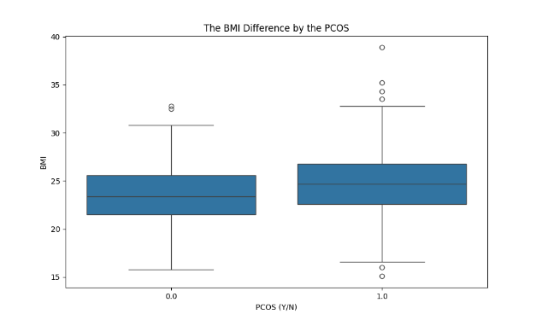
Hypothesis Test for Body Mass Index
This visualization illustrates the BMI among the patients with PCOS and without PCOS.
The left box corresponds with patients that do not have PCOS and the right box is for patients that have PCOS
The line within the box indicates if the BMI for patients with PCOS is higher or lower. The BMI is higher for patients with PCOS which we can see on the right side of the boxplot. The BMI can impact infertility in people just because a lot of things come into play when your weight is either higher or lower.
Non PCOS
PCOS

Slide 11
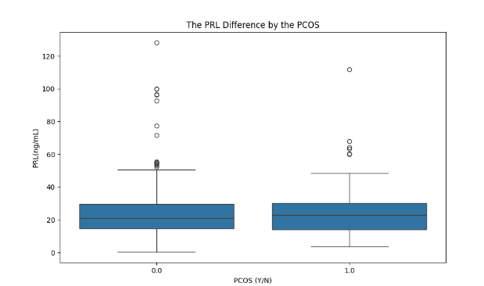
Hypothesis Visualizations for Hormonal Levels
This visualization illustrates the Hormonal levels among the patients with PCOS and without PCOS
From this we can see that patients with PCOS and without PCOS tend to have roughly the same levels for hormonal balance. Patients with PCOS have a higher level. The gap is very small.
Non PCOS
PCOS

Slide 12
TYPES OF PCOS
INSULIN PCOS
POST PILL PCOS
INFLAMMATORY PCOS
ADRENAL PCOS

Slide 13
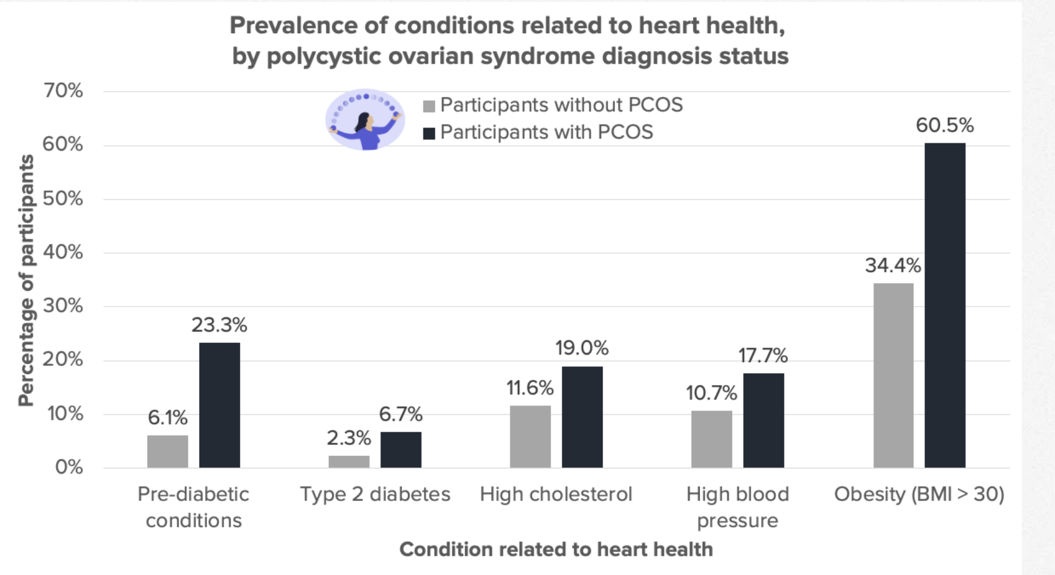

Slide 14
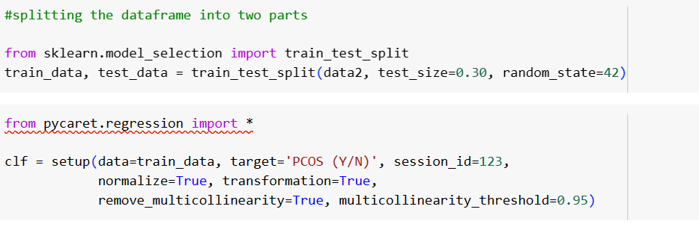
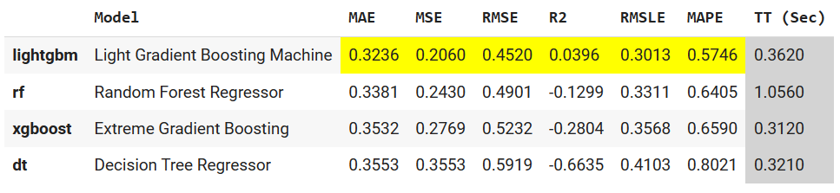
PYCARET

Slide 15
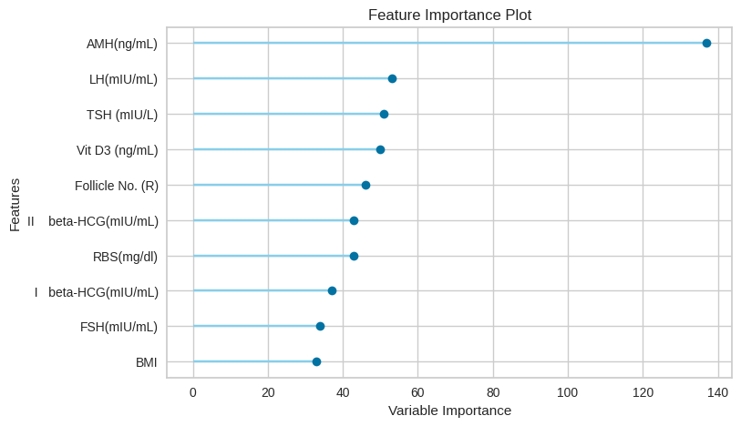
VARIABLE IMPORTANCE

Slide 16
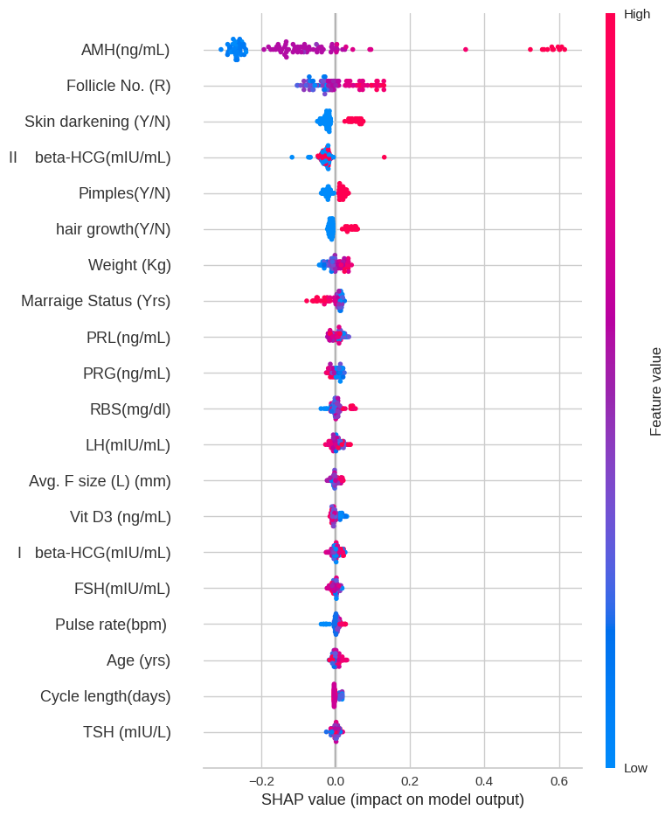
SHAP VALUE
Features towards the top have a greater overall impact on model outcomes. Positive SHAP values typically indicate an increase in the prediction value due to that feature, whereas negative values indicate a decrease.

Slide 17
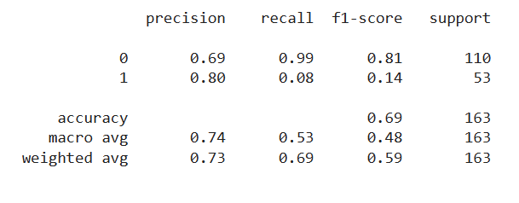
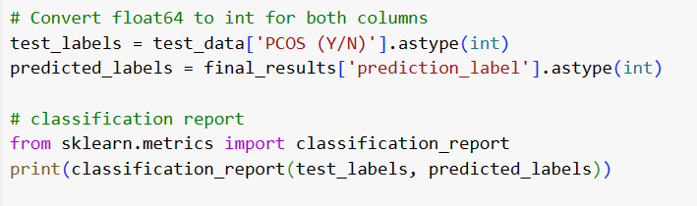
F1-SCORE
Precision: For class 0, the model's precision is 0.69, meaning 69% of the predicted class 0 instances are actually class 0. For class 1, it's 0.80, meaning 80% of the predicted class 1 instances are actually class 1.
Recall: For class 0, the recall is 0.99, meaning the model correctly identifies 99% of all actual class 0 instances. For class 1, the recall is much lower at 0.08, meaning it only identifies 8% of all actual class 1 instances.
F1-Score: A harmonic mean of precision and recall, giving a balance between the two. For class 0, the F1-score is 0.81, indicating a good balance between precision and recall. For class 1, the F1-score is very low at 0.14, reflecting the poor recall.
Support: The number of actual occurrences of each class in the dataset. There are 110 instances of class 0 and 53 instances of class 1.

Slide 18
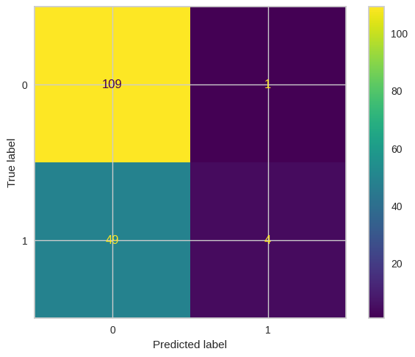
CONFUSION MATRIX
Confusion Matrix
Top-Left: True Negatives (TN) – Correct non-PCOS predictions.
Top-Right: False Positives (FP) – Non-PCOS cases incorrectly classified as PCOS.
Bottom-Left: False Negatives (FN) – PCOS cases incorrectly classified as non-PCOS.
Bottom-Right: True Positives (TP) – Correct PCOS predictions.

Slide 19
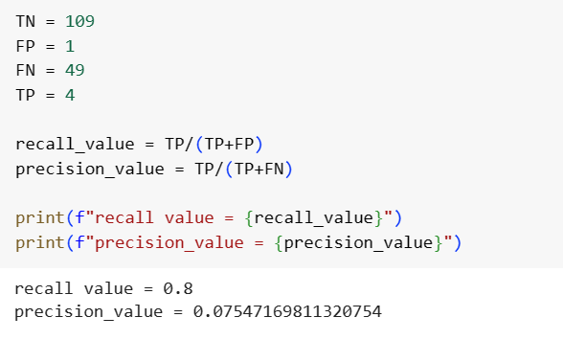
CONFUSION MATRIX
The recall of 0.0755, meaning the model correctly identifies only about 7.55% of all actual PCOS cases, is quite low. This suggests that the model fails to detect the majority of true PCOS cases, which is concerning for a diagnostic tool meant for early detection. Such a low recall rate could lead to many undiagnosed individuals.
Although the model's precision is high at 0.8, indicating that 80% of its positive PCOS predictions are correct, the low recall rate significantly limits the model's overall effectiveness, as it misses many actual cases.

Slide 20
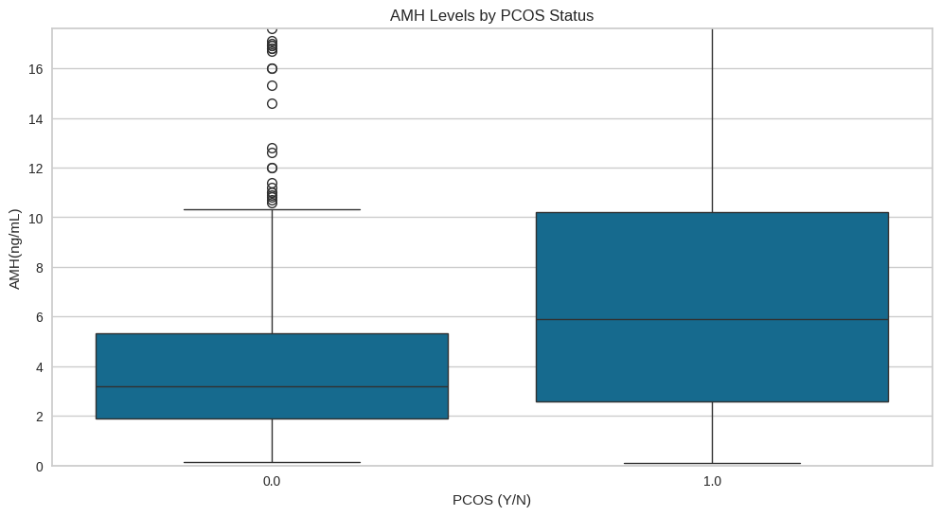
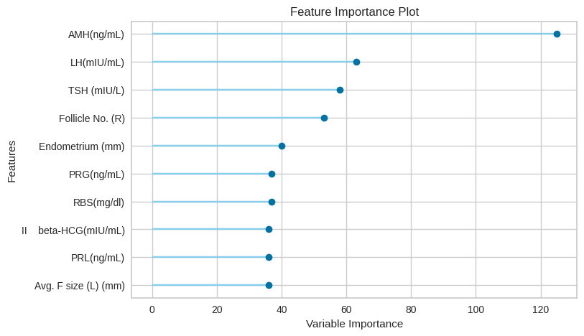
CONCLUSION
Higher AMH values (greater than 1 ng/mL) usually signify that a woman has a normal ovarian reserve.
Conclusion 1: since the AMH level is most likely to be relevant, it indicates that those with PCOS have higher AMH value.

Slide 21
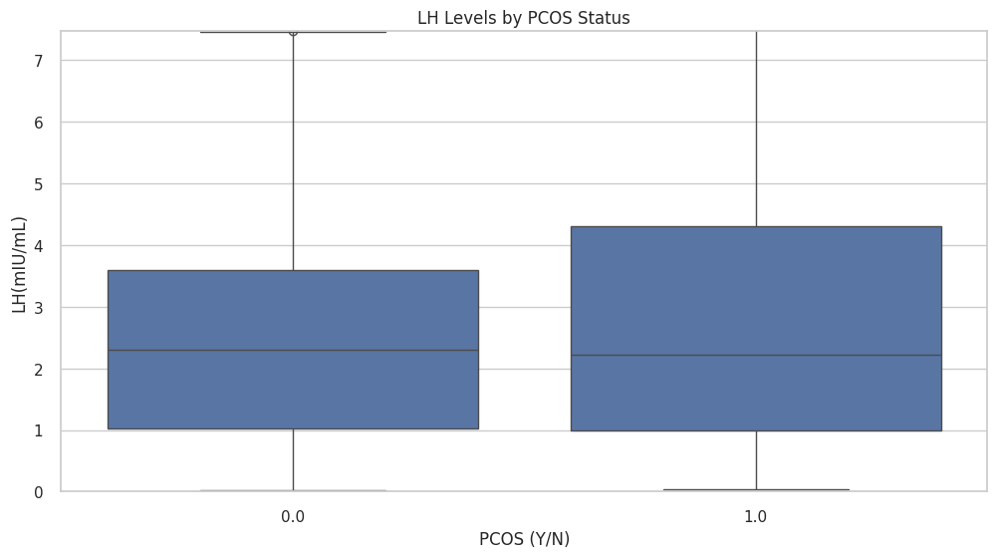
CONCLUSION
Conclusion 4: LH level is likely relevant in women with PCOS compared to those without, supported by the significant difference in the graph.

Slide 22
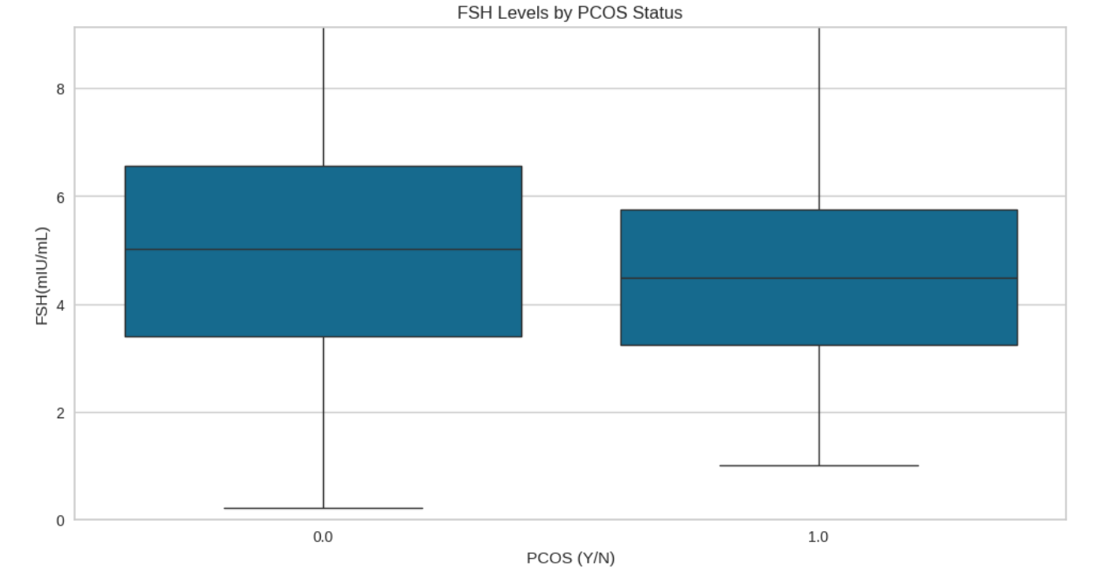
CONCLUSION
Conclusion 3: FSH level is less relevant in women with PCOS compared to those without, supported by the chart.

Slide 23
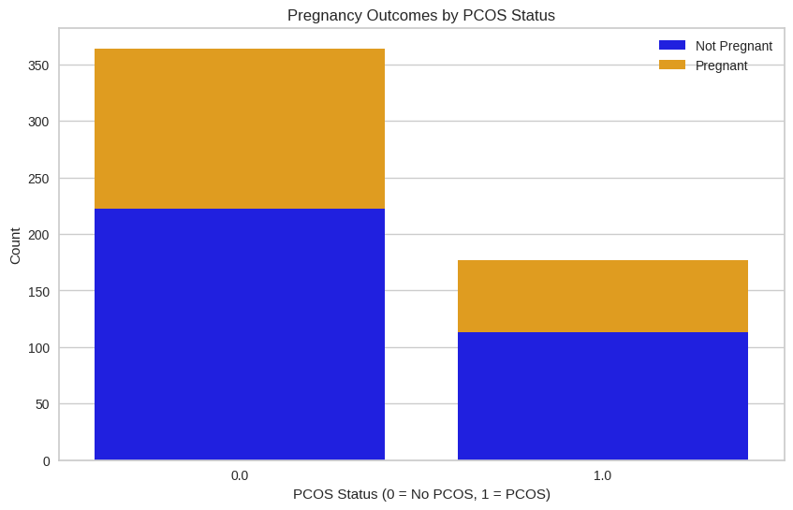
CONCLUSION
Conclusion 2: despite the different counts in pregnancy outcomes between those with and without PCOS, this feature is considered irrelevant.

Slide 24
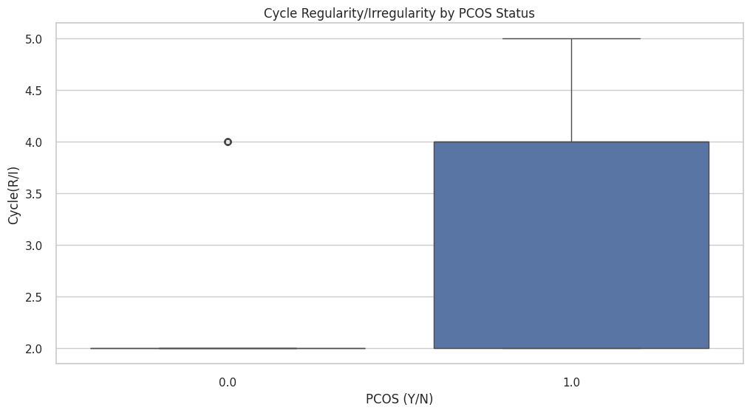
CONCLUSION
Conclusion 5: Despite the significant difference in the chart, the cycle irregularities (“Cycle R/I”) are irrelevant in defining the PCOS.

